Slide 1
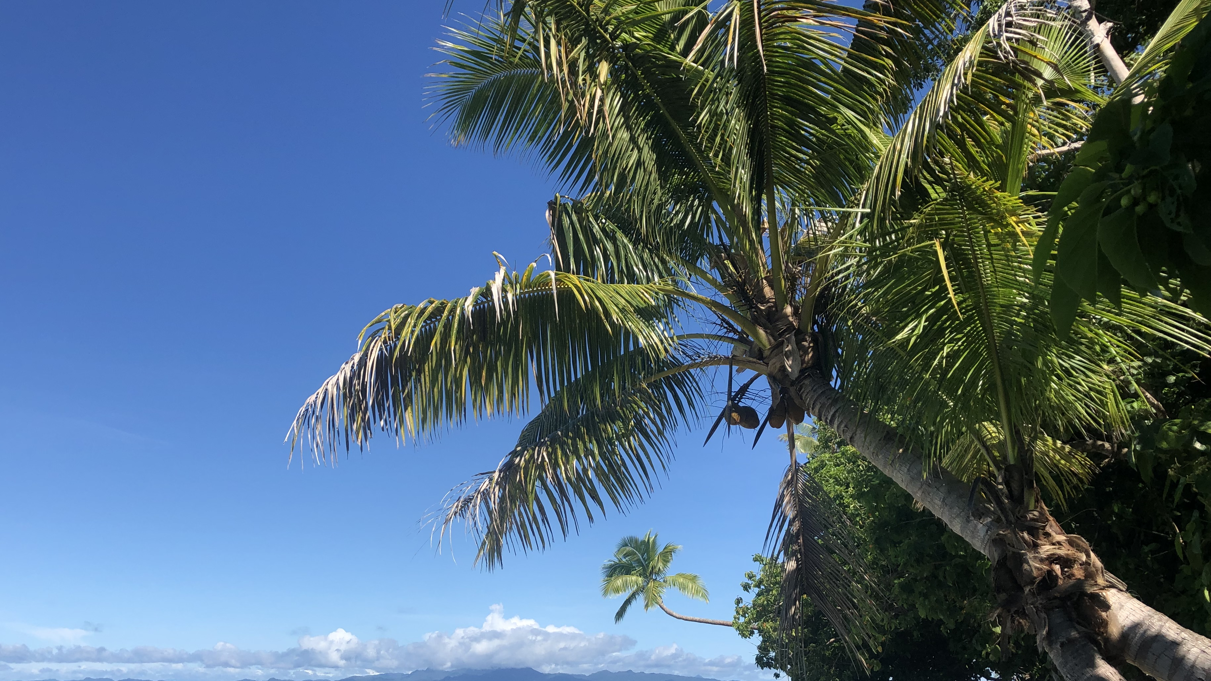
OCN 479-001
Electronics 101

Slide 2
Today’s plan
Lecture
Pick up where you left off with GitHub intro and
Complete second lab activity (building off first)
Oceanographic Instrumentation Lab Tour

Slide 3
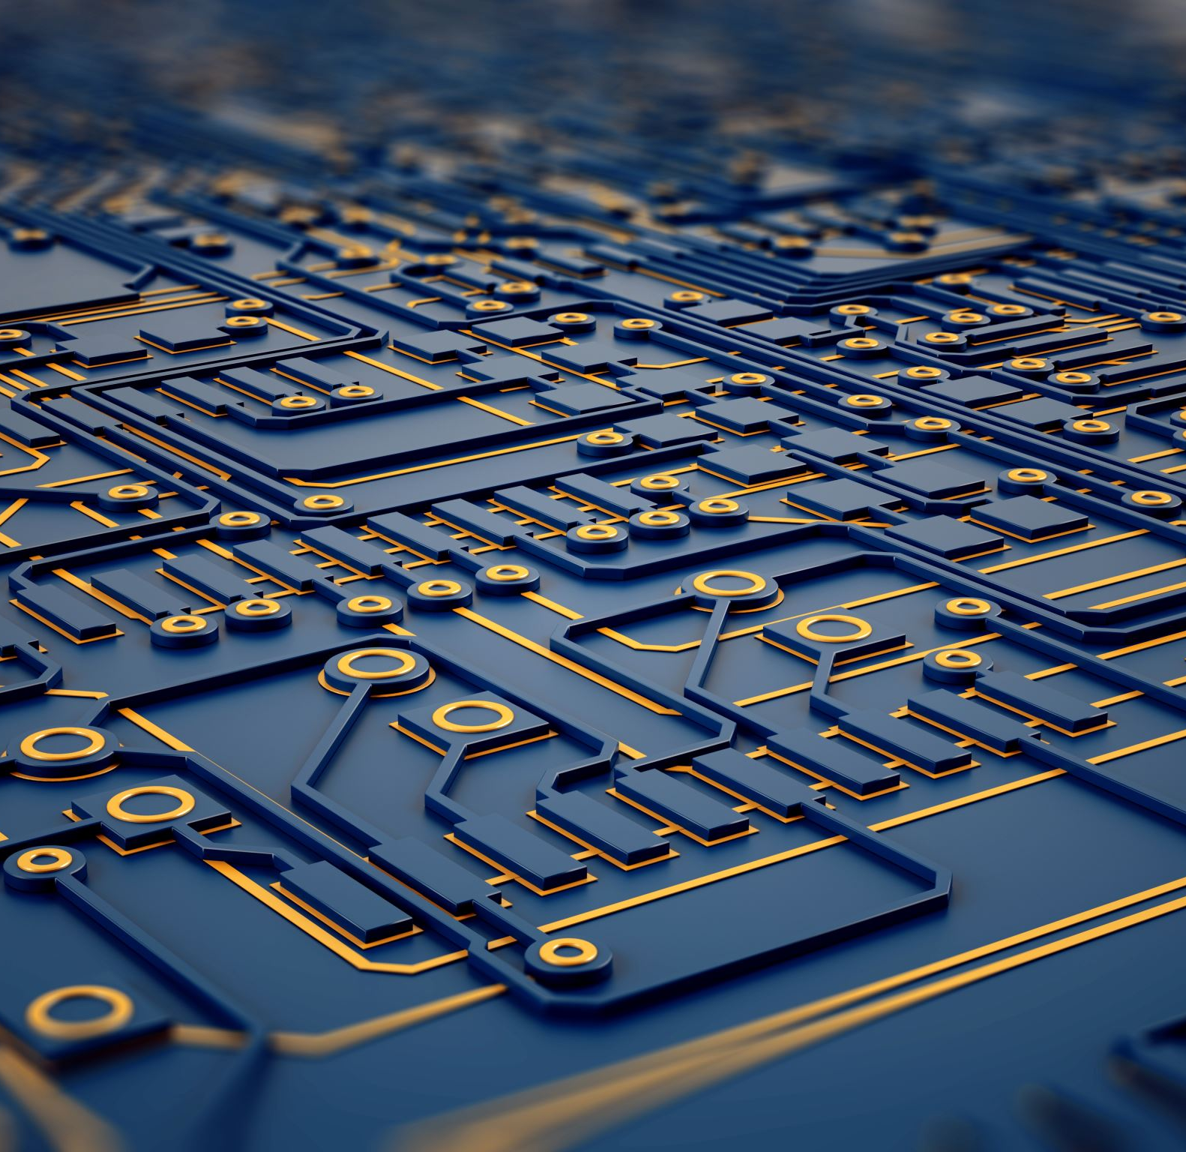
Today’s topics
Working with Electronics 101

Slide 4
Electronics 101
Ohm’s Law: V = IR
Watch https://www.khanacademy.org/science/physics/circuits-topic/circuits-resistance/v/circuits-part-1 for more if additional background needed
Building circuits
Breadboarding circuits
Soldering wires and components
Key electrical components
Power supply (battery)
Resistors
Capacitors
LEDs (often soldered onto boards, sometimes built separately into circuits)
Transistors: one of the most important inventions of the 20th century (Time Magazine)

Slide 5

Next up:
Background and how-to videos

Slide 6
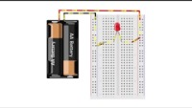
Part 1: How to use a breadboard

Slide 7
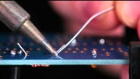
Part 2: Soldering

Slide 8
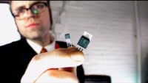
Part 3: Transistors (and way too much bass—sorry)

Slide 9
Part 4: How to use Multimeter
Live demo
Check voltage, resistance, and connectivity of parts of your circuits

Slide 10
Today’s lab
Complete and send me links as described in assignment post on Canvas

Slide 11
Homework (due next week) Everyone—not just 1 per group
Canvas Assignment:
Send me the link to your group’s SOS code repository—see guidelines on next slide
It MUST show at least two github users and that the final version includes changes from a pull request
More information here: https://github.com/SUPScientist/Smart-Coasts/tree/main/Class-03-Presentation1#lab-exercise.

Slide 12
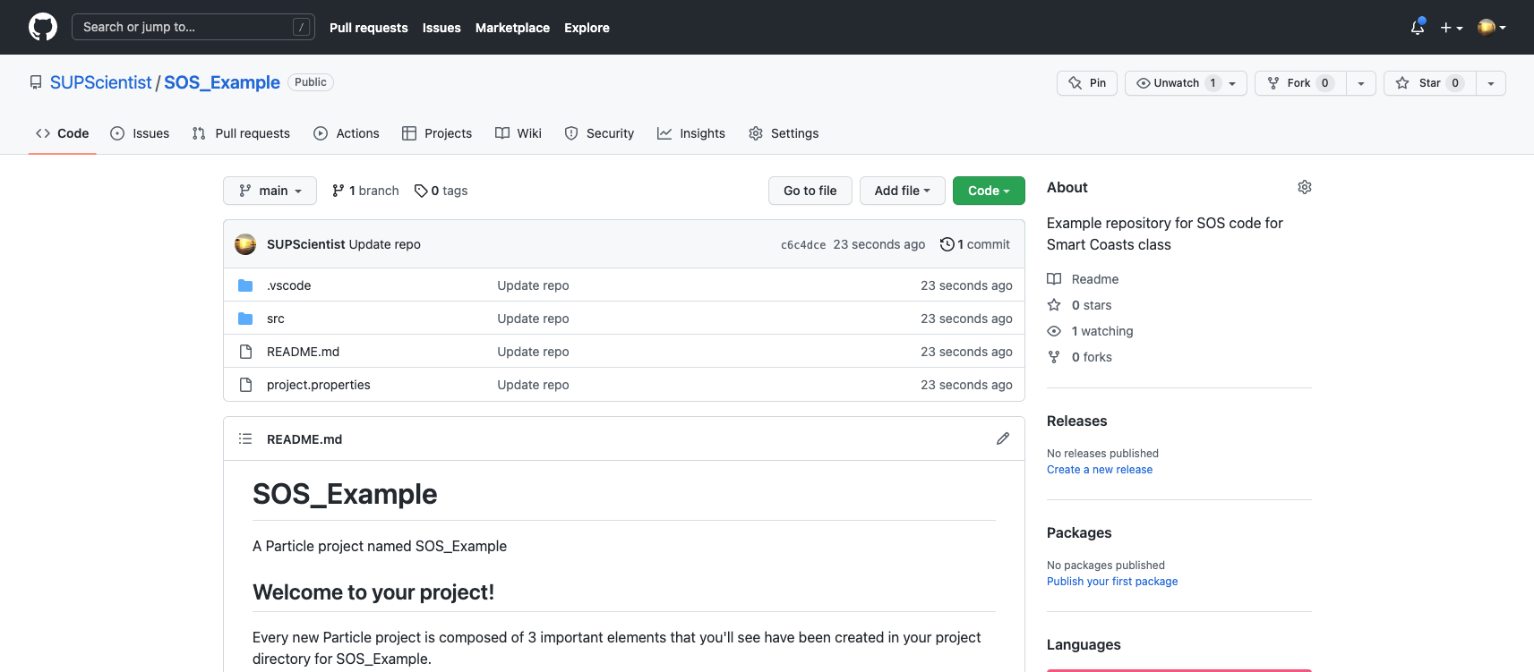
SOS code repository must look like close to this for credit

Slide 13
Grad Students (mandatory) Interested Undergraduates (extra credit)
Short presentation (~ 5’) on why you signed up for this class and what you hope to get out of it
If working on sensor development/sensor communications/datalogging/etc., please include details on your project and, especially, where you think a team of Smart Coasts students might be able to help
We’ll use these to start forming teams/project plans for the rest of the semester where possible (no promises that all “pitches” will be viable projects for this semester, but some may be chosen)

